Slide 1

Chapter 10
More on Objects and Classes

Slide 2
Objectives
To create immutable objects from immutable classes (§10.2).
To prevent multiple declarations using the #ifndef include guard directive (§10.3).
To understand the difference between instance and static variables and functions (§10.4).
To implement destructors to perform customized operations (§10.5).
To create objects using copy constructors with initial data copied from another object of the same type (§10.6).
To customize copy constructors to perform deep copy (§10.7).
To enable friend functions and friend classes to access a class’s private members (§10.8).
To develop classes for modeling composition relationships (§10.9).
To use the C++ vector class as a resizable array (§10.12).

Slide 3
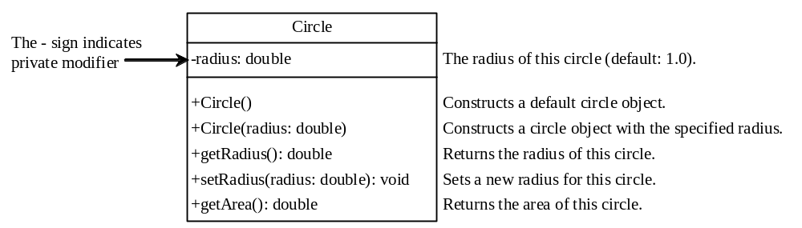
Immutable Objects and Classes
If the contents of an object cannot be changed once the object is created, the object is called an immutable object and its class is called an immutable class. If you delete the set function in the Circle class in Listing 9.5, the class would be immutable because radius is private and cannot be changed without a set function.

Slide 4
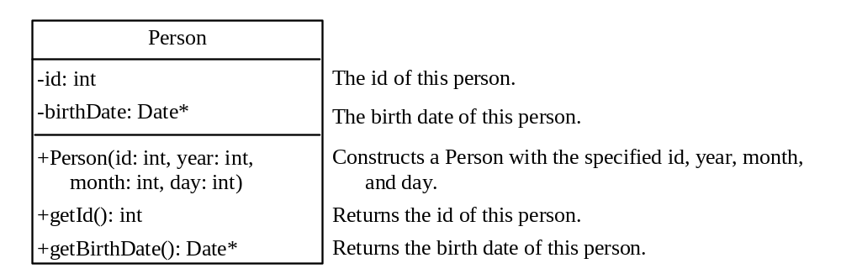
Example
A class with all private data fields and no mutators is not necessarily immutable. To demonstrate this, let us define two classes: Person and Date. Figures 10.1 and 10.2 give the UML class diagrams of these two classes.

Slide 5
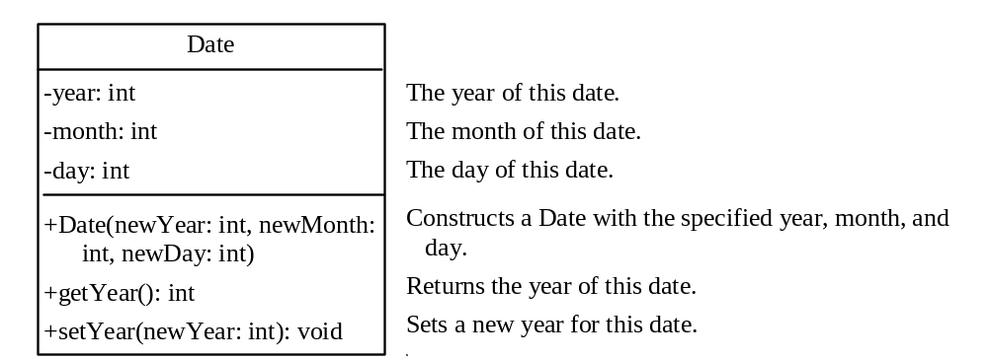
Example

Slide 6
Example Code
Person.h
Person .cpp
Date.h
Date.cpp
TestPerson

Slide 7
Preventing Multiple Declarations
It is a common mistake to include the same header file in a program multiple times inadvertently. For example, you may also add the header file for the Date class, as shown in Listing 10.6, because Date is used in this program. If so, you would get a compile error to indicate that there are multiple declarations for Date.
The C++ #ifndef directive can be used to prevent a header file from being included multiple times. This is known as inclusion guard.
TestPerson1
Date1

Slide 8
Instance and Static Members
The data fields in the classes so far are known as instance data fields, or instance variables. An instance variable is tied to a specific instance of the class; it is not shared among objects of the same class.
If you want all the instances of a class to share data, use static variables, also known as class variables. Static variables store values for the variables in a common memory location. Because of the common location, all objects of the same class are affected if one object changes the value of a static variable. C++ supports static functions as well as static variables.
Static variables or static functions can be called without creating an instance of the class. Of course, you can also call the static variables or functions from instances.

Slide 9
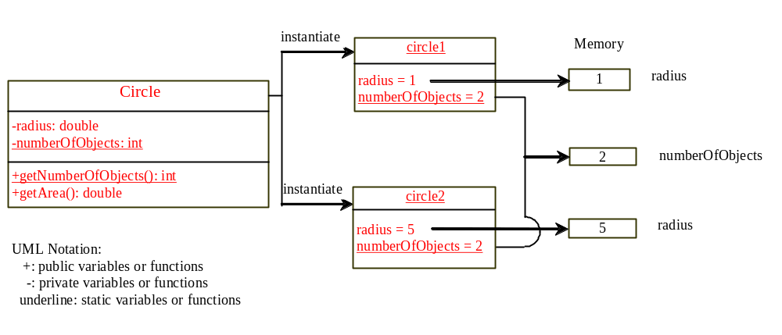
Instance and Static Members
Circle5.h
TestCircle5.cpp
Circle5.cpp

Slide 10
Use Class Name
Use ClassName::functionName(arguments) to invoke a static function and ClassName::staticVariable.
This improves readability because the user can easily recognize the static function and data in the class.

Slide 11
Instance or Static?
How do you decide whether a variable or function should be instance or static? A variable or function that is dependent on a specific instance of the class should be an instance variable or function. A variable or function that is not dependent on a specific instance of the class should be a static variable or function. For example, every circle has its own radius. Radius is dependent on a specific circle. Therefore, radius is an instance variable of the Circle class. Since the getArea function is dependent on a specific circle, it is an instance function. Since numberOfObjects is not dependent on any specific instance, it should be declared static.

Slide 12
Destructors
Destructors are the opposite of constructors. A constructor is invoked when an object is created and a destructor is invoked when the object is destroyed. Every class has a default destructor if the destructor is not explicitly defined. Sometimes, it is desirable to implement destructors to perform customized operations. Destructors are named the same as constructors, but you must put a tilde character (~) in front of it. Listing 10.11 shows a Circle class with a destructor defined.
Circle6.h
TestCircle6.cpp
Circle6.cpp

Slide 13
Copy Constructors
Each class may define several overloaded constructors and one destructor. Additionally, every class has a copy constructor. The signature of the copy constructor is:
ClassName(ClassName &)
For example, the copy constructor for the Circle class is
Circle(Circle &)
The copy constructor can be used to create an object initialized with another object’s data. By default, the copy constructor simply copies each data field in one object to its counterpart in the other object. Listing 10.14 demonstrates this.
CopyConstructorDemo

Slide 14
Shallow Copy vs. Deep Copy
The default copy constructor or assignment operator for copying objects performs a shallow copy, rather than a deep copy, meaning that if the field is a pointer to some object, the address of the pointer is copied rather than its contents. Listing 10.15 demonstrates this.
ShallowCopyDemo

Slide 15
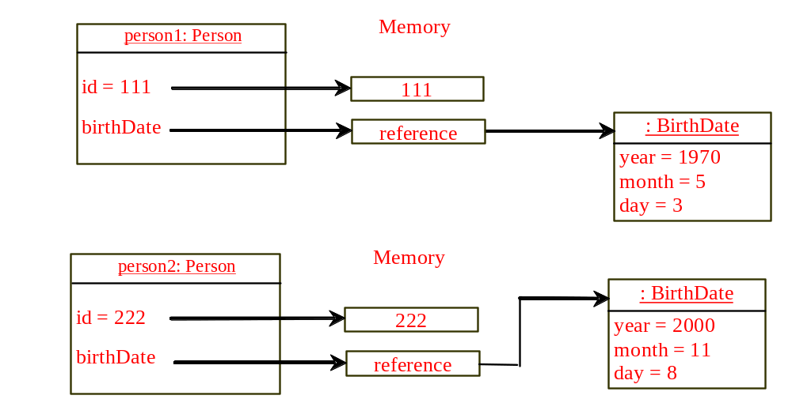
Shallow Copy
Before person2 is copied to person1, the birthDate field of person1 and person2 point to two different Date objects.

Slide 16
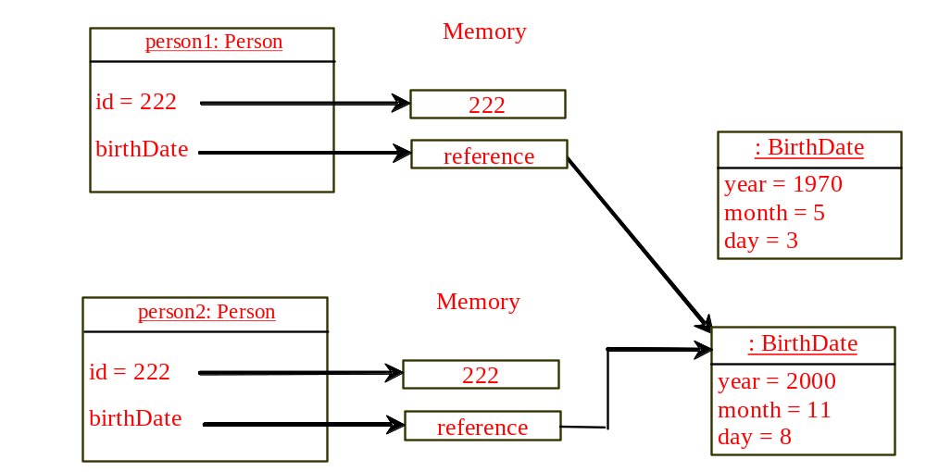
Shallow Copy
After person2 is copied to person1, the birthDate field of person1 and person2 point to the same Date objects.

Slide 17
Customizing Copy Constructor
As discussed in the preceding section, the default copy constructor or assignment operator = performs a shallow copy. To perform a deep copy, you can implement the copy constructor. Listing 10.16 revises the declaration for the Person class to declare a copy constructor in line 12.
Person1 .h
Person1.cpp
CustomCopyConstructor

Slide 18
Friend Functions and Classes
Private members of a class cannot be accessed from outside of the class. Occasionally, it is convenient to allow some trusted functions and classes to access a class’s private members. C++ enables you to use the friend keyword to declare friend functions and friend classes for a class so these functions and classes can access the class’s private members.

Slide 19
Friend Classes
Date2 .h
Date2 .cpp
TestFriendClass

Slide 20
Friend Functions
TestFriendFunction

Slide 21
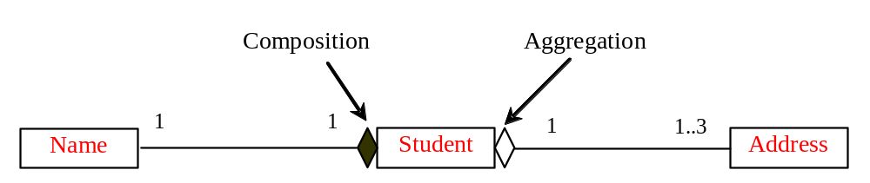
Object Composition
Composition is actually a special case of the aggregation relationship. Aggregation models has-a relationships and represents an ownership relationship between two objects. The owner object is called an aggregating object and its class an aggregating class. The subject object is called an aggregated object and its class an aggregated class.

Slide 22
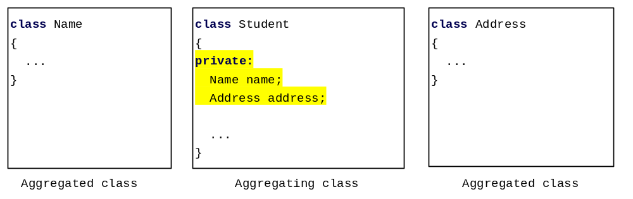
Class Representation
An aggregation relationship is usually represented as a data field in the aggregating class. For example, the relationship in Figure 10.6 can be represented as follows:

Slide 23
Aggregation or Composition
Since aggregation and composition relationships are represented using classes in similar ways, many texts don’t differentiate them and call both compositions.

Slide 24
The C++ vector Class
The preceding two examples use arrays to store students and int values. There is a serious limitation: the array size is fixed in the class declaration. C++ provides the vector class, which is more flexible than arrays. You can use a vector object just like an array, but a vector’s size can grow automatically if needed.

Slide 25
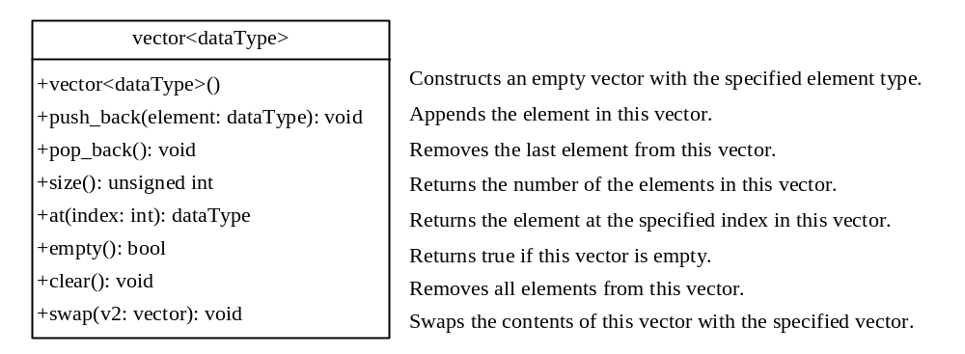
The C++ vector Class
TestVector

Slide 26
Chapter Summary
If the contents of an object can not be changed (except through memberwise copy), once the object is created, the object is called an immutable object and its class is called an immutable class.
For a class to be immutable, it must make all data fields private and provide no mutator functions and no accessor functions that would return a pointer to a mutable data field object.
The C++ #ifndef directive can be used to prevent a header file from being included multiple times.
An instance variable or function belongs to an instance of a class. Its use is associated with individual instances. A static variable is a variable shared by all instances of the same class. A static function is a function that can be invoked without using instances.
Notes:
Immutable 不变的

Slide 27
Chapter Summary
Every instance of a class can access the class’s static variables and functions. However, it is better to invoke static variables and functions using ClassName::staticVariable and ClassName::staticFunctionName(arguments) for clarity.
Destructors are the opposite of constructors. Constructors are invoked to create objects and destructors are invoked automatically when the object is destroyed. Every class has a default destructors if the destructor is not explicitly defined.
Each class may define several overloaded constructors and one destructor. Additionally, every class has a copy constructor. You may use the default copy constructor, or redefine it. By default, the copy constructor simply copies each data field in one object to its counterpart in the other object.
Notes:
Immutable 不变的

Slide 28
Chapter Summary
The friend keyword can be used to give the trusted functions and classes access to a class’s private members.
The array size is fixed after it is created. C++ provides the vector class, which is more flexible than arrays. You can use a vector object just like an array, but a vector’s size can grow automatically if needed.24
Notes:
Immutable 不变的

